Slide 1




Yassmin Abd El Monsif
COST OF LIVING
CLIENT: WARNER & SPENCER

Slide 2

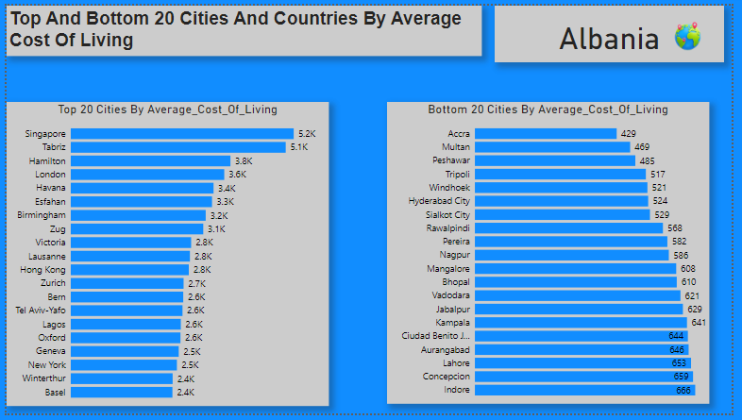
Top And Bottom 20 Cities And
Countries By Average Cost Of Living

Slide 3
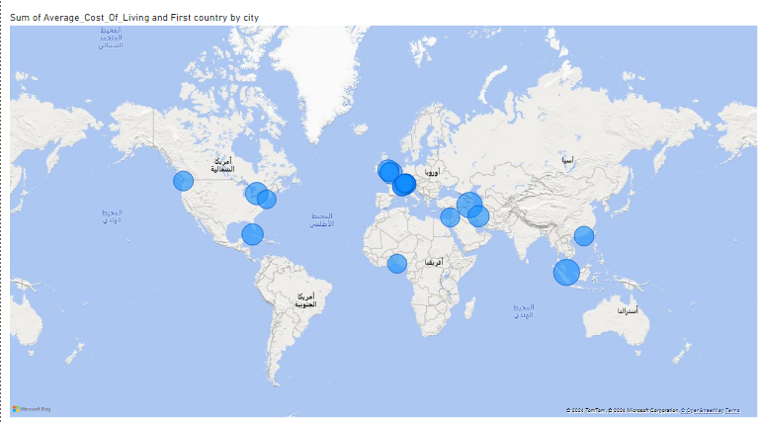
Top 20 Cities Map Visuals

Slide 4
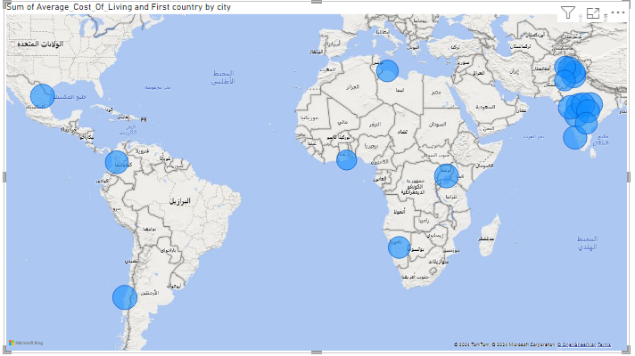
Bottom 20 Cities Map Visuals

Slide 5
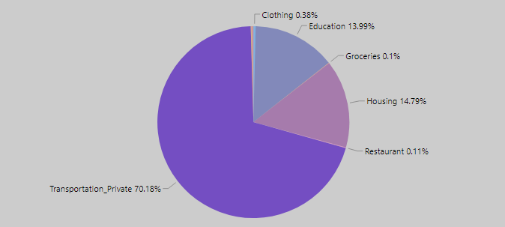
The Major Cost Components Contributing
To The Overall Cost Of Living

Slide 6
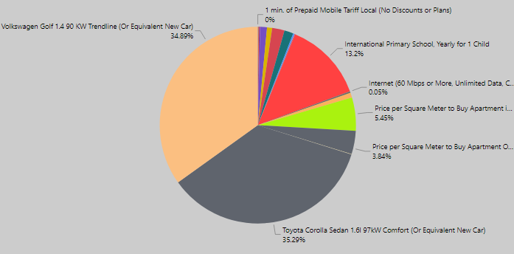
Major Cost Components Contributing To
The Overall Cost Of Living

Slide 7
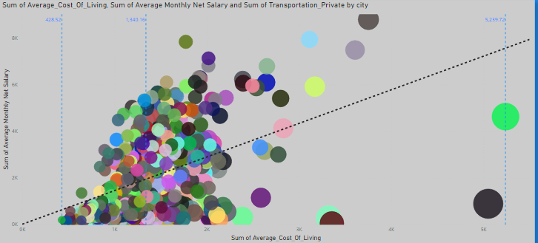
How Average Salary And Transportation
Corelates with Cost of Living

Slide 8
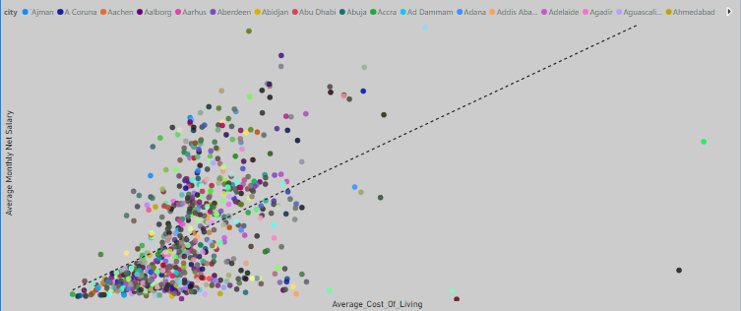
How Average Salary And Housing Expenses
Corelates with Cost of Living

Slide 9
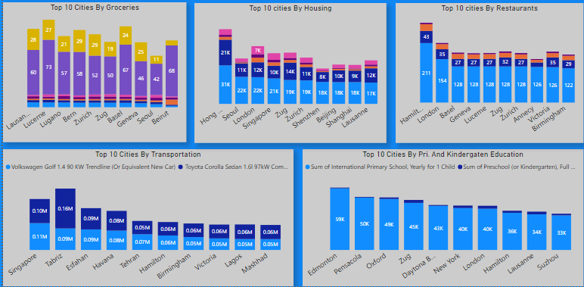
Most Expensive Cities And Countries

Slide 10
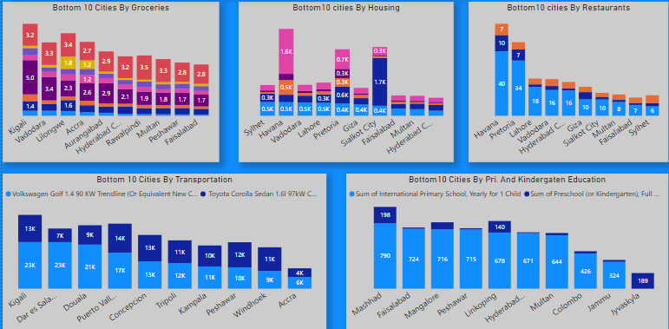
Least Expensive Cities And Countries

Slide 11
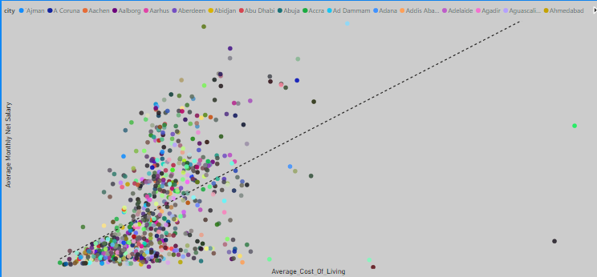
Salary To Cost Of Living Gap

